Slide 1
AI Career Counselor (Rural Youth) agent
CAPSTONE PROJECT
Presented By: UJJWAL KAILASH RASTOGI
Student name : UJJWAL KAILASH RASTOGI
College Name & Department : MPSTME AND DEPARTMENT-DATA SCIENCE

Slide 2
OUTLINE
Problem Statement
Technology used
Wow factor
End users
Result
Conclusion
Git-hub Link
Future scope
IBM Certifications

Slide 3
Problem Statement
Young people and students in rural locations frequently lack access to formal career coaching because there are not enough competent mentors and counsellors are available. Low knowledge of government programs, online training platforms, and job-oriented courses .Language and connection barriers becomes a discrepancy between talents and open positions may lead to underemployment or career stagnation in mostly rural areas. So finding relevant career possibilities, local employment trends, or resources for skill development by hand is time-consuming, inconvenient, and inconsistent for under-represented populations.

Slide 4
SOLUTION pROPOSED
An AI Career Counselor Agent that uses Natural Language Processing (NLP), Retrieval-Augmented Generation (RAG), and real-time trusted data to:
Provide personalized career guidance based on users’ interests, location, education, and aptitude
Recommend job-oriented courses, vocational training programs, and relevant government schemes.
Connect users with free or affordable online learning platforms and local skilling initiatives.
Suggest career paths, growth potential, and future-ready skills in regional languages.
Help discover scholarships, internships, or entry-level opportunities based on eligibility.
Suggest and recommend mentors or collaborators using available career network APIs.
This smart agent will act as a scalable, multilingual, and always-available virtual career guide for rural youth, enabling data-driven, accessible, and empowering career decisions.

Slide 5
Technology used
IBM cloud lite services
Natural Language Processing (NLP)
Retrieval Augmented Generation-SKILLDEVELOPMENTFORRURALEMPLOYMENTININDIA , Skill-Saathi-Guidelines and more Docs as Vector index
IBM Granite 3-3-8b-instruct model

Slide 6
IBM cloud services used
IBM Cloud Watsonx AI Studio
IBM Cloud Watsonx AI runtime
IBM Cloud Agent Lab
IBM Granite foundation model
IBM Watson Assistant for natural language conversations
Cloud Functions for scalable processing
IBM Cloudant for reliable data storage

Slide 7
Wow factors
Personalized Career Guidance
Assesses individual skills, interests, and educational background
Provides customized career recommendations based on local and national market demands
Adapts advice to account for geographical constraints and opportunities
Course and Government Scheme Recommendations
Curates relevant educational programs from online platforms
Identifies suitable government initiatives and subsidies for skill development
Filters opportunities based on eligibility criteria and local accessibility
Learning Ecosystem Integration
Connects users with online learning platforms suited to their connectivity conditions
Maps local skill development centers and training programs
Creates personalized learning pathways considering resource constraints
Career Path Planning
Projects long-term career trajectories based on current skills and market trends
Identifies critical skill gaps and recommends development strategies
Provides milestone-based progression plans with realistic timelines
Opportunity Discovery
Uncovers scholarship opportunities for further education
Highlights apprenticeships and entry-level positions

Slide 8
End users
Direct End Users: Rural Youth
Educational Institutions & NGOs
Government Agencies
Employers & Industries
Mentors & Trainers
End Use | Primary Beneficiary | Impact
Breaking Language Barriers | Rural Youth | Career advice in 10+ Indian languages (e.g., Hindi, Tamil, Bengali).
Low-Bandwidth Optimization | All Users | Works on 3G networks; offline resource downloads.
Data-Driven Policy Input | Government | Real-time insights into rural employment trends for policy adjustments.
Scalable Mentorship | NGOs/Educators | 1 mentor can guide 100+ users via AI-assisted workflows.

Slide 9
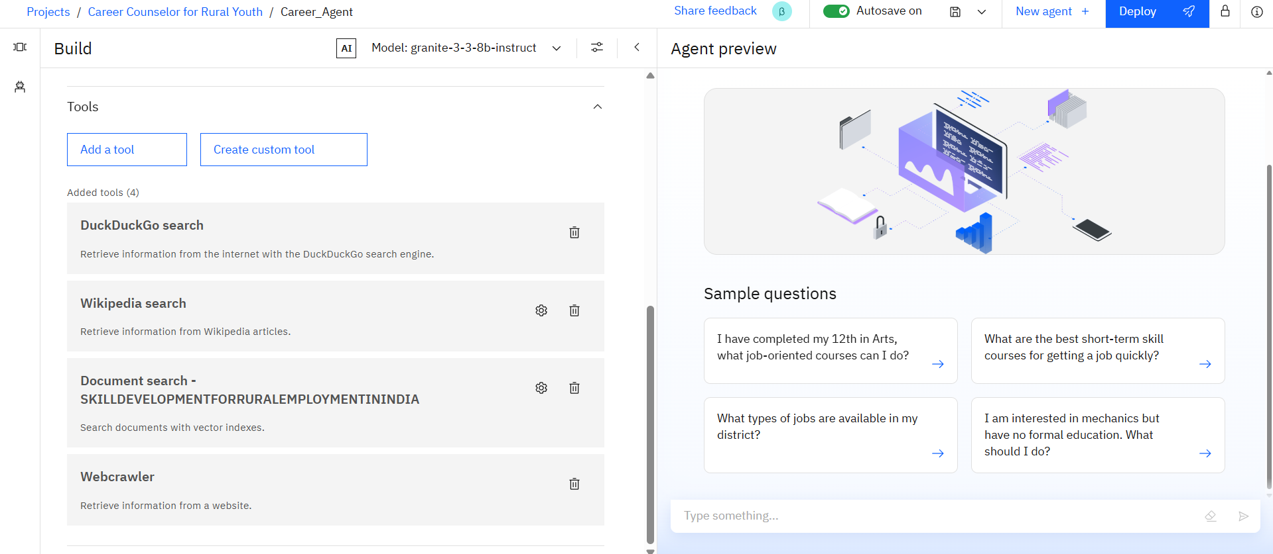
Results

Slide 10
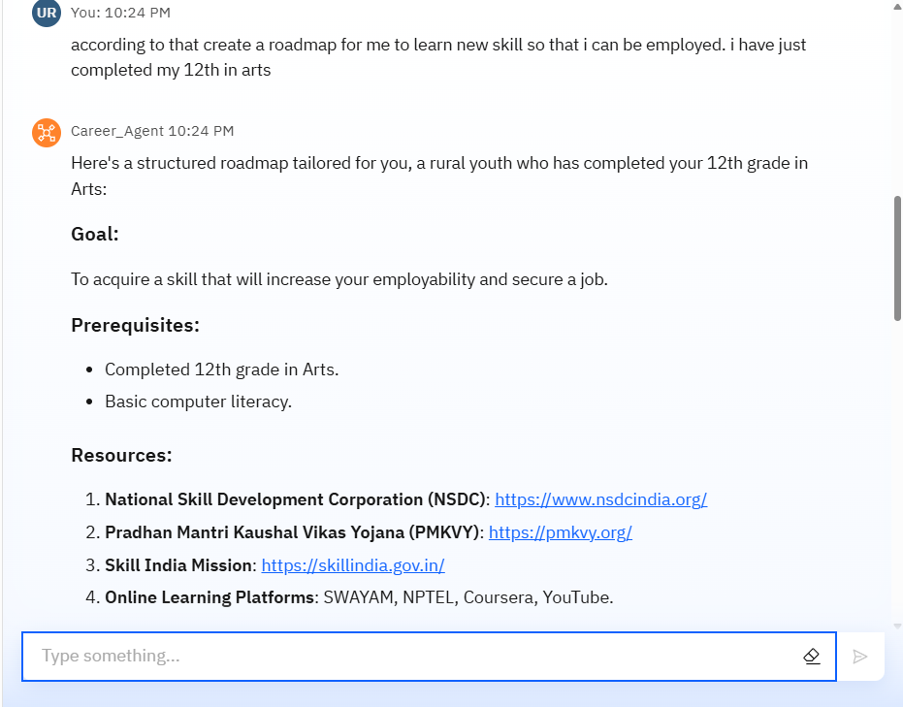
Results

Slide 11
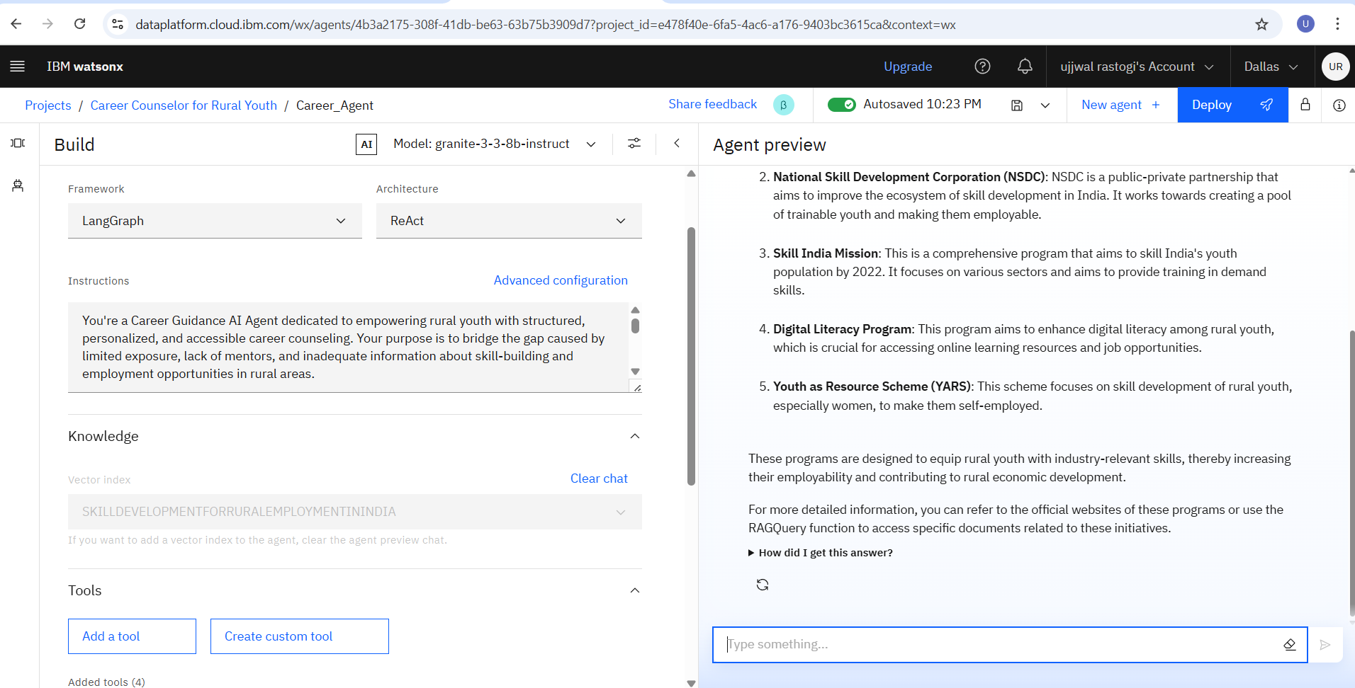
Results

Slide 12
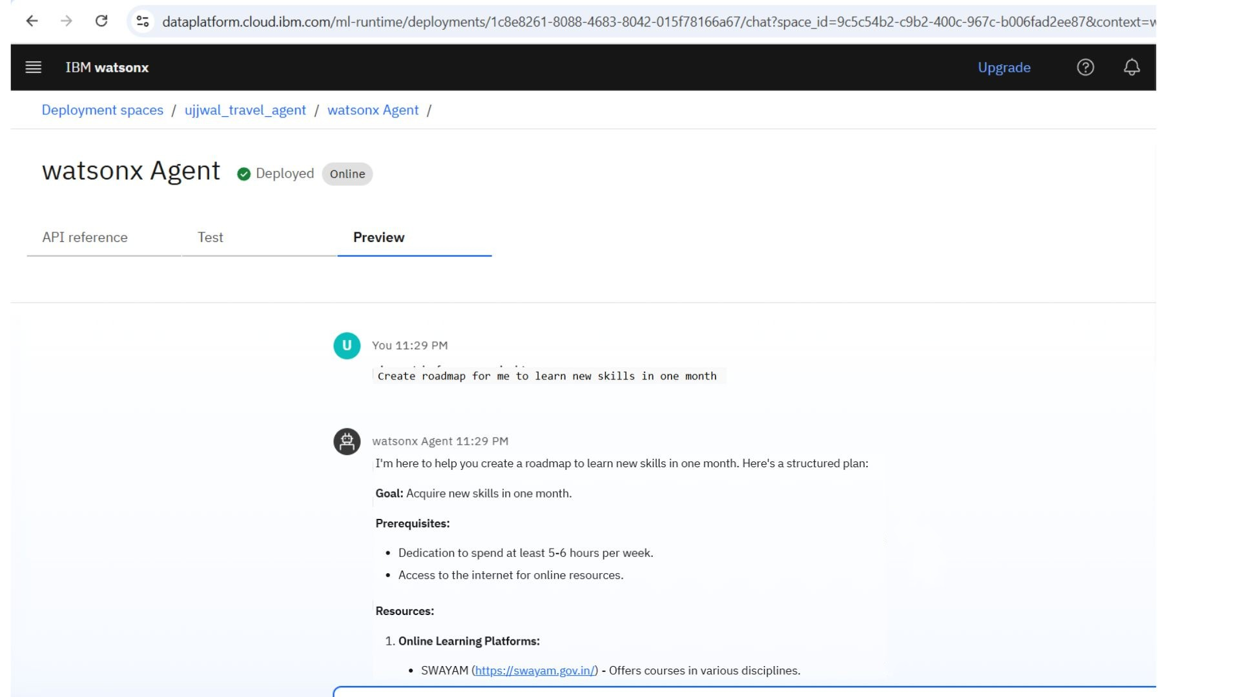
Results
Deployed AI Agent

Slide 13
Conclusion
The agent provides personalized career recommendations based on individual interests, skills, and local opportunities.
It bridges the information gap by offering real-time updates on scholarships, entrance exams, vocational training, and job openings.
AI Career Agents enhance awareness, confidence, and decision-making, empowering rural youth to pursue meaningful and attainable career paths.

Slide 14
Future scope
Multilingual Support
Voice-Activated Assistant
Real-Time Collaboration Features
Education Gap and Topic Identification
Integration with Job Platforms
AI-Assisted Resume Drafting

Slide 15
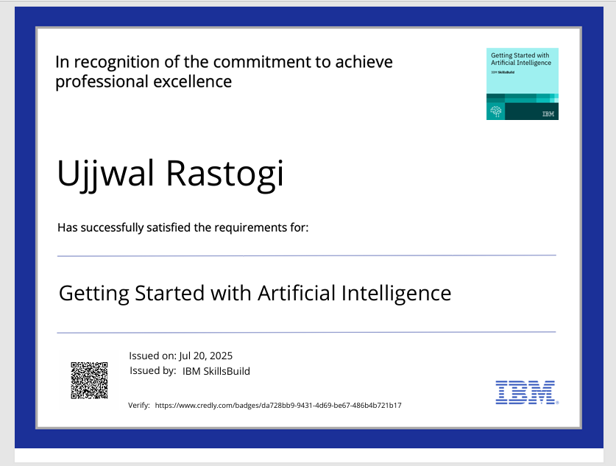
IBM Certifications

Slide 16
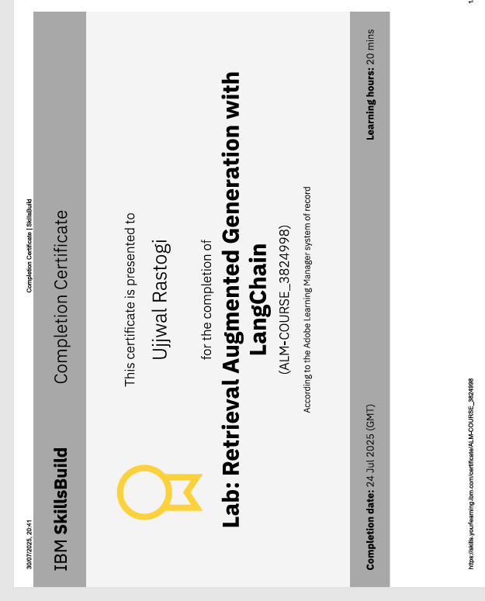
IBM Certifications

Slide 17
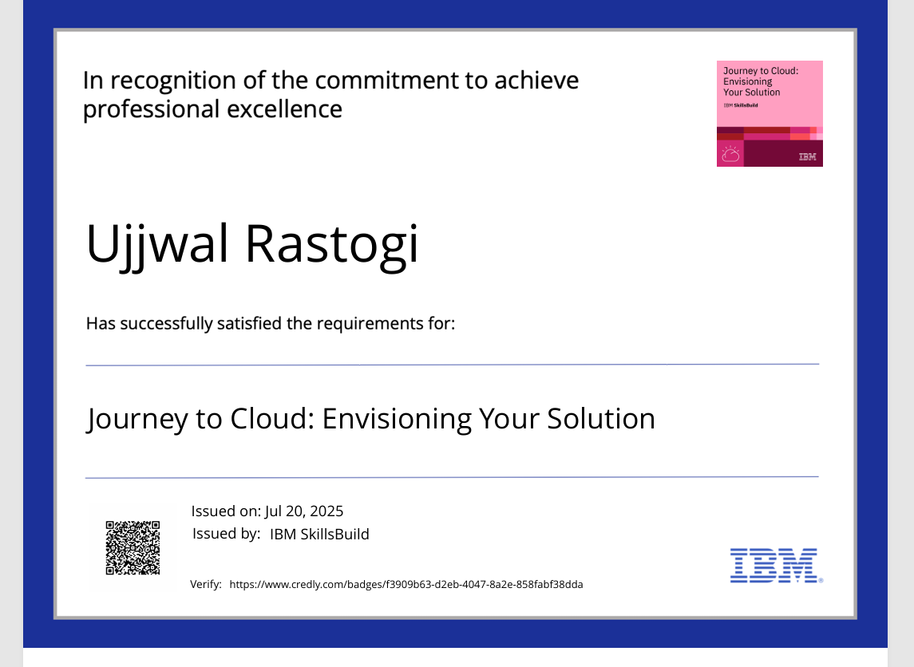
IBM Certifications

Slide 18
Git hub lik : https://github.com/ujjwal-rastogi-ds/AI-Career-Counselor-Agent-for-Rural-Youth

Slide 19
GitHub Link
https://github.com/ujjwal-rastogi-ds/AI-Career-Counselor-Agent-for-Rural-Youth

Slide 20
THANK YOU

